Slide 1

PyClustering: BANG Tutorial
Pyclustering Library Tutorial
Theme: BANG
Library Version: 0.8.2
Author: Andrei Novikov
E-Mail: pyclustering@yandex.ru

Slide 2
Agenda
PyClustering BANG Features;
Input format for BANG;
Data clustering using BANG;
Data clustering result visualization;
Animation of BANG clustering process;
Image segmentation by BANG;

Slide 3
PyClustering BANG Features
BANG algorithm provides clustering results that can be used for further analysis (not only clusters and noise itself): dendrogram, BANG directory - information about density distribution, structure, approximate amount of real clusters and influence of input argument on clustering results.
BANG visualizer for clustering results, BANG directory and dendrogram.
BANG animator for creating animation of BANG clustering process.

Slide 4
Import BANG
BANG algorithm and its features can be imported from „pyclustering.cluster.bang“:
from pyclustering.cluster.bang import bang
from pyclustering.cluster.bang import bang_directory
from pyclustering.cluster.bang import bang_visualizer
from pyclustering.cluster.bang import bang_animator

Slide 5
Input data format for BANG
BANG algorithm uses array_like data format, for example, list where each element is a point that is represented by coordinates. Here is an example of 1-D data:
dataset = [ [0.25], [0.43], [1.34], [-0.56] ]
Example of 2-D data:
dataset = [ [0.1, 0.2], [0.1, 0.6], [0.2, -1.4] ]
Example of 3-D data:
dataset = [ [0.6, 0.1, 0.4], [0.2, 0.1, 0.9] ]

Slide 6
Clustering by BANG algorithm
BANG uses one general parameter for clustering: level of division that technically means amount of BANG tree hight where root is a cell that covers whole data.
from pyclustering.cluster.bang import bang
data = [ [0.1], [0.2], [0.5], [0.3], [1.5], [1.8], [1.3], [1.6], [1.5] ]
levels = 3
instance = bang(data, levels)
instance.process() # perform processing
clusters = instance.get_clusters(); # allocated clusters
noise = instance.get_noise(); # cluster noise
directory = instance.get_directory(); # BANG directory
dendrogram = instance.get_dendrogram() # BANG dendrogram

Slide 7
Output result of BANG
BANG algorithm returns allocated clusters, outliers (noise), BANG directory and dendrogram:
Clusters are represented by list of clusters and each cluster contains object indexes from dataset.
Outliers are represented by list of object indexes from dataset.
BANG directory is a object of class bang_directory.
Dendrogram is represented by list of dendrogram clusters where each cluster contains expand order of blocks that was formed during clustering process.

Slide 8
BANG result visualization
Output result such as clusters and outliers can be shown by common visualizer „cluster_visualizer“ from „pyclustering.cluster“ or by BANG visualizer:
instance = bang(sample, levels)
instance.process()
clusters = instance.get_clusters() # allocated clusters
noise = instance.get_noise() # outliers
directory = instance.get_directory() # get BANG directory
# visualize clustering results
bang_visualizer.show_clusters(sample, clusters, noise)
bang_visualizer.show_dendrogram(dendrogram)
bang_visualizer.show_blocks(directory)

Slide 9
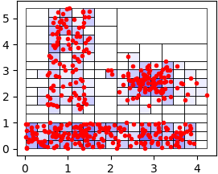
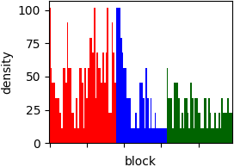
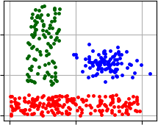
BANG visualization – Lsun
Visualization of BANG clustering results. Data: ‚Lsun‘.
BANG blocks and their
densities
BANG dendrogram of
three formed clusters
Allocated clusters by
BANG algorithm

Slide 10
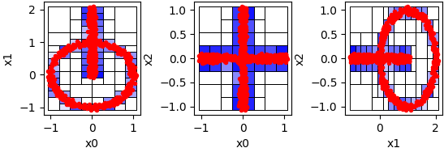
BANG visualization – Chainlink
BANG visualizer is able to display clustering result of N-dimension data by forming pair x_{k}, x_{l}, where k, l – dimension indexes.
BANG blocks representation in case 3-dimensional data

Slide 11
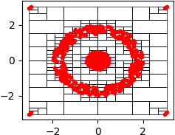
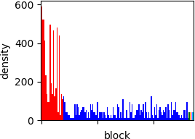
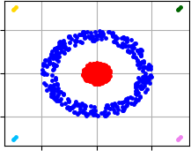
BANG visualization - Target
Visualization of BANG clustering results. Data: ‚Target‘.
BANG blocks and their
densities
BANG dendrogram of
three formed clusters
Allocated clusters by
BANG algorithm

Slide 12
Animate BANG clustering process
BANG clustering process can be animated (in case of 2-dimensional data) using services of class ‚bang_animator‘.
instance = bang(data, levels, density_threshold)
instance.process()
# obtain BANG clustering result for creating animation
clusters = instance.get_clusters()
noise = instance.get_noise()
directory = instance.get_directory()
# show animation
bang_animator(directory, clusters, noise).animate()
# or save animation to file
bang_animator(directory, clusters, noise).animate(movie_filename=bang.mp4)

Slide 13
BANG for segmentation
BANG can consider image as a data where each point represent pixel with three coordinate (RGB), or with four coordinate (RGBA). Here is an example of image segmentation using BANG algorithm:
from pyclustering.utils import draw_image_mask_segments, read_image
from pyclustering.cluster.bang import bang;
data = read_image(file_path_to_image);
bang_instance = bang(data, levels, density_threshold);
bang_instance.process();
clusters = bang_instance.get_clusters();
draw_image_mask_segments(source, clusters);

Slide 14
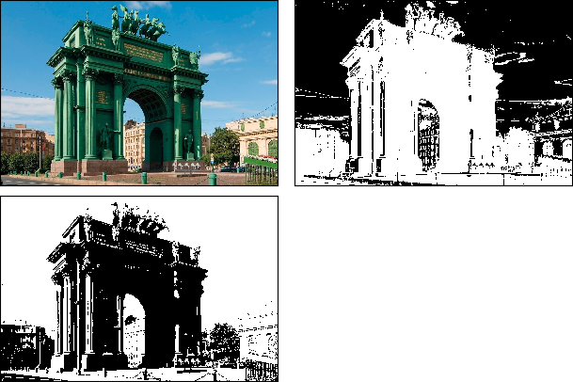
Image segmentation results
Example of image segmentation of photo from St.-Petersburg by BANG algorithm using pyclustering.
Shortcoming of BANG segmentation
is not trivial way to set density
Threshold, especially to handle
Images with color gradient

Slide 15
References and Links
Official pyclustering github repository:
https://github.com/annoviko/pyclustering
Official pypi pyclustering page:
https://pypi.org/project/pyclustering/
Official pyclustering web-site:
https://pyclustering.github.io/

Slide 16
Thank you for your attention
Thank you!

